Slide 1
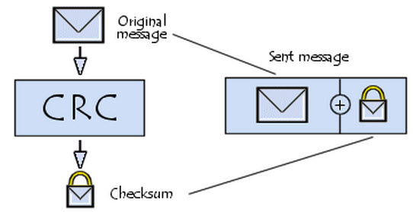
CRC – Data Link Layer
Networks Assignment

Slide 2
Presented by
Arwa Ibrahim Muhamed
Ahmed Ragab Shaaban
Raheeq Alaa-Eldeen Muhamed
Ahmad Ashraf Abdelfatah

Slide 3

Project Description
Our program consists of 3 Parts:
Generator Program: reads message input & polynomial from the input file, and then outputs the message to be transmitted.
Verifier Program: Checks whether the message is correct or not.
Altering Code: a command that alters the message and sends it to the verifier to ensure that it’s doing its function properly and outputting an error in that case.

Slide 4
How to use
Download the .exe file and the sample test cases from GitHub
Run the program and choose the mode
Mode 1: Verifying mode, should output “Correct!!” as it’s the same message.
Mode 2: Altering, it alters the left-most bit and then runs (Mode 1) again, should output “Error!!” as the message has been altered.

Slide 5
Sample I/O – Test Cases

